Slide 1
Medical Acupuncture in Pediatric Pain Management SIAATIP International Congress October 15, 2021
Juliane H Lee, MD, MS
Department of Anesthesiology
Division of Pediatric Anesthesiology & Pain Management
Riley Hospital for Children, Indianapolis

Slide 2
Disclosure Information for: Juliane Lee, MD Resident Lecture Medical Acupuncture
Juliane Lee is Director of Institute for Athletic Acupuncture, LLC.
There is no sponsorship/commercial support of this presentation/program
The content being presented will be fair, well-balanced and evidence-based.

Slide 3
GOALS
Introduce principles of medical acupuncture
Discuss the most common disorders for which medical acupuncture is effective
Discuss how to use medical acupuncture as an adjunct therapy to alleviate pain and other some other common symptoms

Slide 4
OBJECTIVES
List 2 barriers to conventional pharmacological approaches commonly seen, that make medical acupuncture an appealing option (PONV, NPO)
List 2 disorders that typically respond well to acupuncture therapy

Slide 5
MEDICAL ACUPUNCTURE
Principles of Chinese Medicine
Adjuncts to Western Medicine
Clinical Reports
Basic Science
Auricular Acupuncture
Clinical Experience in Pediatric Setting
Division of Pediatric Anesthesiology

Slide 6
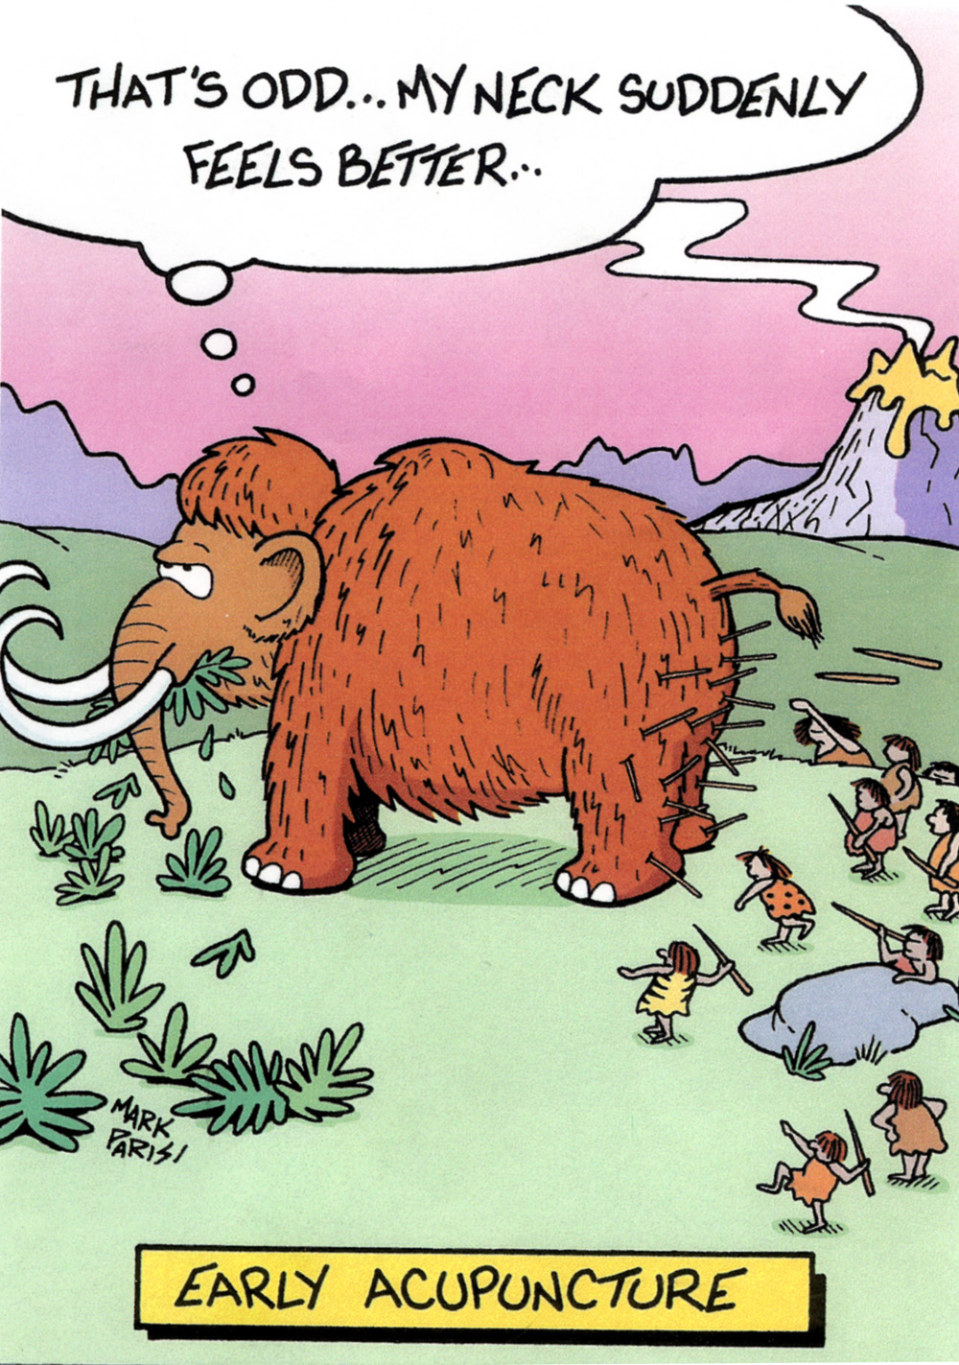
Division of Pediatric Anesthesiology

Slide 7
Goal of Acupuncture
The application of sterile needles on specific points on the surface of the body to Facilitate Movement of Qi
Along Meridians to restore or promote maintenance of health
Division of Pediatric Anesthesiology

Slide 8
BASIC CONSTITUENTS
Qi
Xue
Jin Ye
Jing
Shen
Energy
Blood
Body Fluids
Life Essence
Spirit
Division of Pediatric Anesthesiology

Slide 9
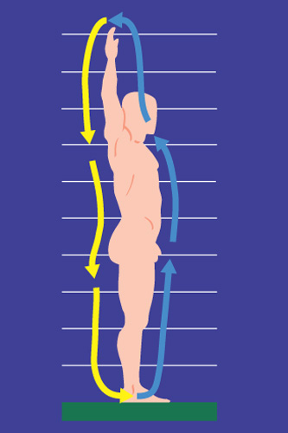
Division of Pediatric Anesthesiology

Slide 10
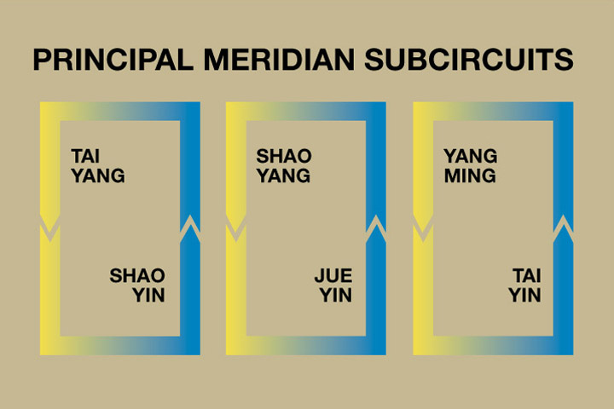
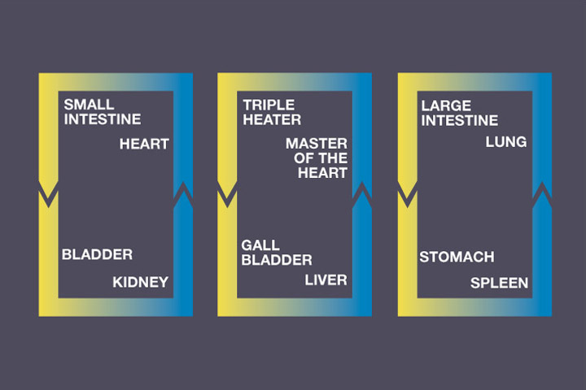
PRINCIPAL MERIDIAN SYSTEM
Circuits on which Qi flows; Each governs health of an organ system
Division of Pediatric Anesthesiology

Slide 11
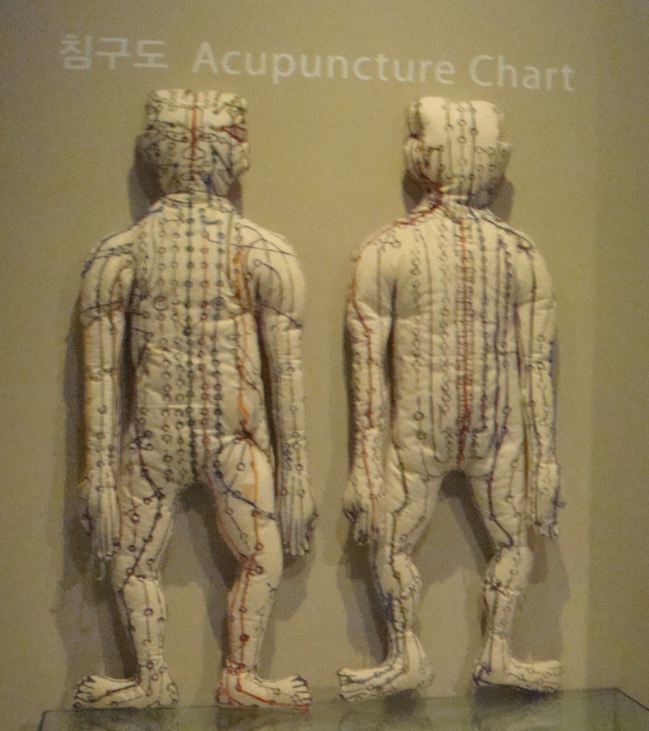
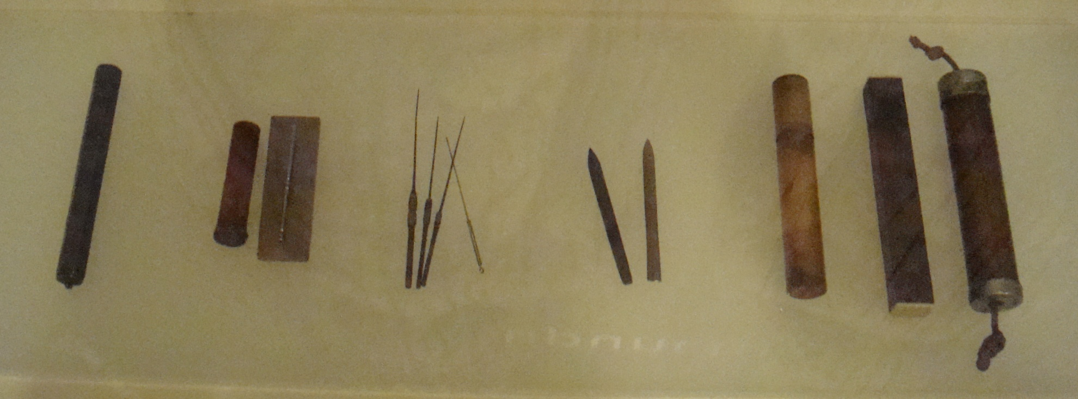
From the Korean National Museum
Division of Pediatric Anesthesiology

Slide 12
Acupuncture as an Adjunct
Failed all other therapies
Inadequate symptom management
Medication refusal/limitation/contraindication
Limited opiate use: renal/hepatic disease, risk for respiratory problems: obesity, asthma, OSA, central apnea, nasopharyngeal edema
Severe/intractable medication Side effects: Pruritis, N/V, Sedation, Respiratory depression, Hallucinations, Urinary retention, Seizures
Difficulty weaning from opioids
Co-morbid Anxiety, Depression
Disorders with high response rate: headache, abdominal pain, N/V, CRPS, neuropathic pain, musculoskeletal pain, stress, anxiety

Slide 13
Evaluation
Complete history and physical focused on:
Symptoms
Alleviating & aggravating factors
Past successful & failed therapies
Effect on function – school performance & attendance, sleep, diet, social, extracurriculars
Physical therapy
Psychology therapy

Slide 14
Assessment
Quality of Symptom
Intensity, location, quality, aggravating/alleviating factors
Appropriate Pain Rating Tools: VAS or Numerical Rating Scale NRS, FACES, FLACC (Face, Leg, Activity, Cry, Consolability)
Reassess & Document Before & After each intervention
Educate Patient & Family about Pain & Symptom Management, Establishing Realistic Goals

Slide 15
HOW DID WE BECOME INTERESTED IN ACUPUNCTURE?
1971: New York Times Journalist James Reston covered President Nixon’s pivotal visit to China
Developed acute appendicitis; wrote about his experience with acupuncture (The New York Times, July 26, 1971: 1, 6)
Widely publicized account sparked intense interest in acupuncture in the US

Slide 16
1992 NIH: Office of Alternative Medicine
1993 FDA: Technology Assessment Conference
1996 WHO: Training, Safety, Applications
1997 NIH: Consensus Development Conference
2002 WHCCAMP White House Commission on Complementary and Alternative Medicine Policy
Division of Pediatric Anesthesiology

Slide 17
WORLD LITERATURE SURVEY: Clinical Research
Organic Lesion 40%
Pain Disorders 25%
Surgical Analgesia 10%
Neurological Disorders 10%
Substance Abuse 5%
Psychiatric Disorders 5%
Acupuncture Energetics, JM Helms, 1995
Division of Pediatric Anesthesiology

Slide 18
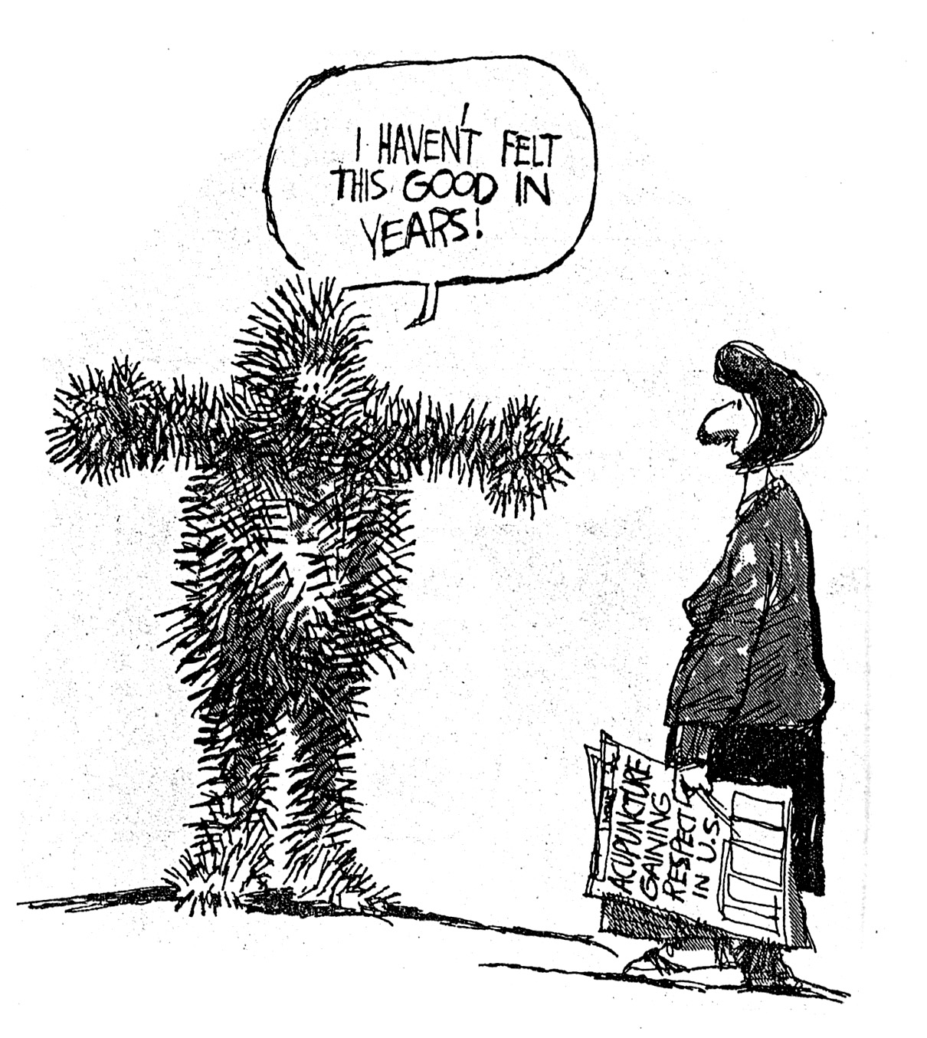
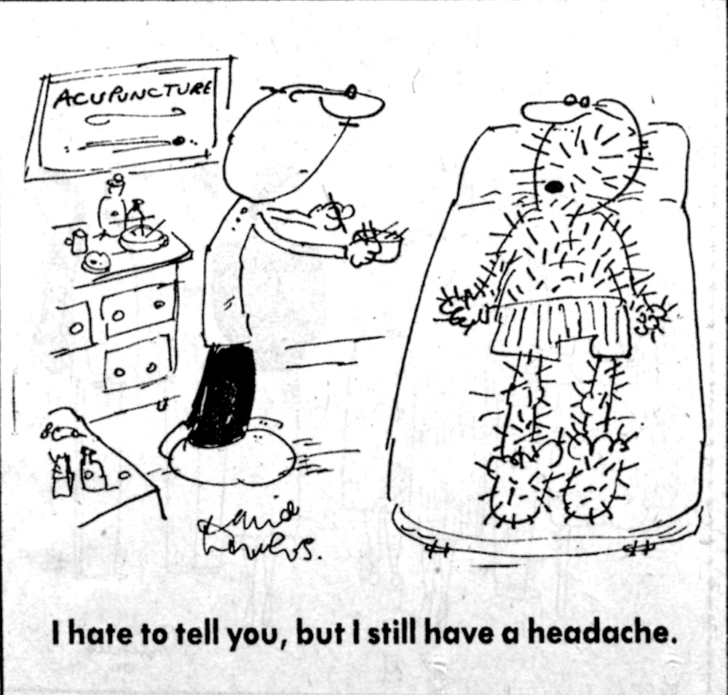
Division of Pediatric Anesthesiology

Slide 19
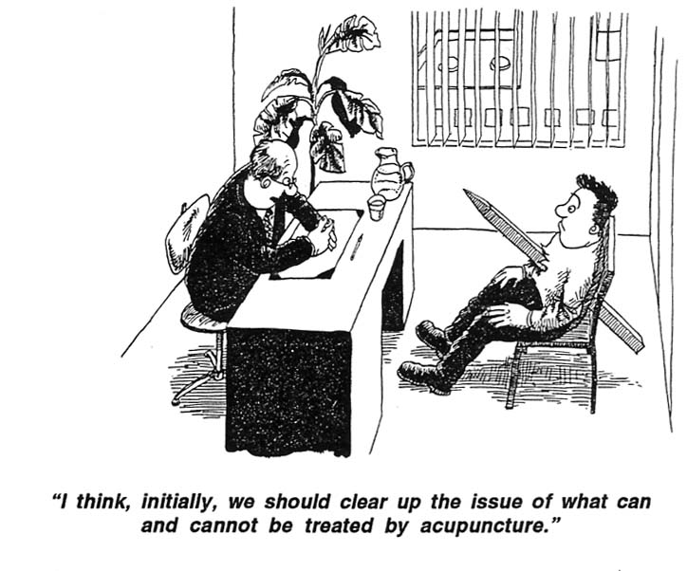
Division of Pediatric Anesthesiology

Slide 20
Controlled Prospective
Clinical Efficacy
Studies Are Lacking
Division of Pediatric Anesthesiology

Slide 21
Acupuncture for chronic headache in primary care: large, pragmatic, randomised trial
AJ Vickers et al. BMJ 2004;328:744 (MSKCC)
Objective To determine the effects of a policy of “use acupuncture” on headache, health status, days off sick, and use of resources in patients with chronic headache compared with a policy of “avoid acupuncture.”
Design Randomised, controlled trial.
Participants 401 patients with chronic headache, predominantly migraine.
Interventions Patients were randomly allocated to receive up to 12 acupuncture treatments over three months or to a control intervention offering usual care.
Main outcome measures Headache score, SF-36 health status, and use of medication were assessed at baseline, three, and 12 months. Use of resources was assessed every three months.
Results Headache score at 12 months, the primary end point, was lower in the acupuncture group (16.2, SD 13.7, n = 161, 34% reduction from baseline) than in controls (22.3, SD 17.0, n = 140, 16% reduction from baseline). The adjusted difference between means is 4.6 (95% confidence interval 2.2 to 7.0; P = 0.0002). This result is robust to sensitivity analysis incorporating imputation for missing data. Patients in the acupuncture group experienced the equivalent of 22 fewer days of headache per year (8 to 38). SF-36 data favoured acupuncture, although differences reached significance only for physical role functioning, energy, and change in health. Compared with controls, patients randomised to acupuncture used 15% less medication (P = 0.02), made 25% fewer visits to general practitioners (P = 0.10), and took 15% fewer days off sick (P = 0.2).
Conclusions Acupuncture leads to persisting, clinically relevant benefits for primary care patients with chronic headache, particularly migraine. Expansion of NHS acupuncture services should be considered

Slide 22
Acupuncture for tension-type headache., K Linde et al. Cochrane Database Syst Rev. 2009 Jan 21;(1):CD007587.
OBJECTIVES:
To investigate whether acupuncture is a) more effective than no prophylactic treatment/routine care only; b) more effective than 'sham' (placebo) acupuncture; and c) as effective as other interventions in reducing headache frequency in patients with episodic or chronic tension-type headache.
SELECTION CRITERIA:
We included randomized trials with a post-randomization observation period of at least 8 weeks that compared the clinical effects of an acupuncture intervention with a control (treatment of acute headaches only or routine care), a sham acupuncture intervention or another intervention in patients with episodic or chronic tension-type headache.
MAIN RESULTS: Eleven trials with 2317 participants (median 62, range 10 to 1265) met the inclusion criteria. Two large trials compared acupuncture to treatment of acute headaches or routine care only. Both found statistically significant and clinically relevant short-term (up to 3 months) benefits of acupuncture over control for response, number of headache days and pain intensity. Long-term effects (beyond 3 months) were not investigated. Six trials compared acupuncture with a sham acupuncture intervention, and five of the six provided data for meta-analyses. Small but statistically significant benefits of acupuncture over sham were found for response as well as for several other outcomes. Three of the four trials comparing acupuncture with physiotherapy, massage or relaxation had important methodological or reporting shortcomings. Their findings are difficult to interpret, but collectively suggest slightly better results for some outcomes in the control groups.
CONCLUSIONS:
In the previous version of this review, evidence in support of acupuncture for tension-type headache was considered insufficient. Now, with six additional trials, the authors conclude that acupuncture could be a valuable non-pharmacological tool in patients with frequent episodic or chronic tension-type headaches.

Slide 23
Acupuncture for chronic low back pain in older patients: a randomized, controlled trial
CF Meng, et al. Rheumatology 2003: 42 (12); 1508-1517. Hospital for Special Surgery
Objective. To determine if acupuncture is an effective, safe adjunctive treatment to standard therapy for chronic low back pain (LBP) in older patients.
Methods. The inclusion criteria for subjects were: (i) LBP ≥12 weeks and (ii) age ≥60 yr; the exclusion criteria were (i) spinal tumour, infection or fracture and (ii) associated neurological symptoms. The subjects were randomized to two groups. The control group of subjects continued their usual care as directed by their physicians, i.e. NSAIDs, muscle relaxants, paracetamol and back exercises. Subjects in the acupuncture group in addition received biweekly acupuncture with electrical stimulation for 5 weeks. Outcome was measured by the modified Roland Disability Questionnaire (RDQ) at weeks 0, 2, 6 and 9. The primary outcome measure was change in RDQ score between weeks 0 and 6.
Results. Fifty-five patients were enrolled, with eight drop-outs. Twenty-four subjects were randomized to the acupuncture group and 23 were randomized to the control group. Acupuncture subjects had a significant decrease in RDQ score of 4.1 ± 3.9 at week 6, compared with a mean decrease of 0.7 ± 2.8 in the control group (P = 0.001). This effect was maintained for up to 4 weeks after treatment at week 9, with a decrease in RDQ of 3.5 ± 4.4 from baseline, compared with 0.43 ± 2.7 in the control group (P = 0.007). The mean global transition score was higher in the acupuncture group, 3.7 ± 1.2, indicating greater improvement, compared with the score in the control group, 2.5 ± 0.9 (P < 0.001). Fewer acupuncture subjects had medication-related side-effects compared with the control group.
Conclusions. Acupuncture is an effective, safe adjunctive treatment for chronic LBP in older patients.

Slide 24
Meta-Analysis: Acupuncture for Low Back Pain E Manheimer, et al. Ann Intern Med. 2005;142(8):651-663. (University of Maryland School of Medicine
Purpose: To assess acupuncture's effectiveness for treating low back pain.
Study Selection: Randomized, controlled trials comparing needle acupuncture with sham acupuncture, other sham treatments, no additional treatment, or another active treatment for patients with low back pain.
Data Extraction: Data were dually extracted for the outcomes of pain, functional status, overall improvement, return to work, and analgesic consumption. In addition, study quality was assessed.
Data Synthesis: The 33 randomized, controlled trials that met inclusion criteria were subgrouped according to acute or chronic pain, style of acupuncture, and type of control group used. The principal measure of effect size was the standardized mean difference, since the trials assessed the same outcome but measured it in various ways. For the primary outcome of short-term relief of chronic pain, the meta-analyses showed that acupuncture is significantly more effective than sham treatment (standardized mean difference, 0.54 [95% CI, 0.35 to 0.73]; 7 trials) and no additional treatment (standardized mean difference, 0.69 [CI, 0.40 to 0.98]; 8 trials). For patients with acute low back pain, data are sparse and inconclusive. Data are also insufficient for drawing conclusions about acupuncture's short-term effectiveness compared with most other therapies.
Limitations: The quantity and quality of the included trials varied.
Conclusions: Acupuncture effectively relieves chronic low back pain. No evidence suggests that acupuncture is more effective than other active therapies.

Slide 25
Use of Electrical Stimulation at Acupuncture Points for the Treatment of Reflex Sympathetic Dystrophy in a Child: A Case Report. KC Leo et al. PHYS THER. 1983; 63:957-959.
Reflex sympathetic dystrophy (RSD) is a syndrome characterized by persistent, hyperesthetic pain in an extremity with concurrent evidence of autonomic nervous system dysfunction.1 This syndrome frequently results in a serious functional impairment with associated trophic changes that may eventually develop into permanent dysfunction. Reflex sympathetic dystrophy has been referred to as causalgia, reflex neurovascular dystrophy, post-traumatic pain syndrome,
shoulder-hand syndrome, and Sudeck's atrophy. It generally develops after nerve injury, trauma, surgery, cervical osteoarthritis, carcinoma, myocardial infarction, or cerebrovascular accident.1 The antecedent illness or injury may be relatively minor compared with the severity of the symptoms. In some instances, no antecedent injury or illness can be identified. This syndrome is most prevalent in middle-aged and older adults and is infrequently found in children.1"3 Classical
treatments of RSD include active and passive range-of-motion exercises, casting, splinting, administration of corticosteroids, and sympathetic blocks. More recently, transcutaneous electrical nerve stimulation has been demonstrated to produce effective results. The purpose of this report is to describe and contrast the effects of two different types of treatment for two successive occurrences of RSD in a 10-year-old girl.

Slide 26
Six Month Depression Relapse Rates Among Women Treated with Acupuncture. SM Gallagher, et al. Complementary Therapies in Medicine (2001): 9: 216-218. (University of Arizona, Stanford University)
Summary: Conventional treatments for Major Depression, although reasonably effective, leave many without lasting relief. Alternative approaches would therefore be welcome for both short-and long-term treatment of depression. Thirty-eight women were randomized to one of three treatment conditions in a double-blind randomized controlled trial of acupuncture in depression. All participants eventually received eight weeks of acupuncture specifically for depression. From among the 33 women who completed treatment, 26 (79%) were interviewed at six month follow up. Relapse rates were comparable to those of established treatments, with four of the 17 women (24%) who achieved full remission at the conclusion of treatment experiencing a relapse six months later. Compared to other empirically validated treatments, acupuncture designed specifically to treat major depression produces results that are comparable in terms of rates of response and of relapse or recurrence.
These results suggest a larger trial of acupuncture in the acute- and maintenance-phase treatment of depression is warranted.

Slide 27
American Academy of Pain Medicine Annual Meeting 2015

Slide 28
American Academy of Pain Medicine Annual Meeting 2016

Slide 29
BASIC SCIENCE
Measured Effects
Hypothesized Mechanisms
Division of Pediatric Anesthesiology

Slide 30
Endogenous Opioid Peptide System
Beta Endorphins
Enkephalins
Dynorphins
Serotonin
Norepinephrine
JAMA , 1998; 280: 1518-24.
Eur J Pharm. 1992; 211:203-10.
Acetylcholine
Dopamine
GABA
Substance P
Division of Pediatric Anesthesiology

Slide 31
ELECTRO-ACUPUNCTURE
LOW FREQUENCY HIGH INTENSITY
HIGH FREQUENCY LOW INTENSITY
Slow Onset Analgesia
Generalized Effect
Continues After Stimulation
Cumulative Effect
Endorphin Dependent
Reversible by Narcan (Opioid Antagonist)
Eur J Pharm. 1992; 211:203-10.
Rapid Onset Analgesia
Segmental Effect
Active During Stimulation
No Cumulative Effect
Monoamine Dependent
Akin to TENS
Division of Pediatric Anesthesiology

Slide 32
How Acupuncture Works
Electrical Propagation Along Acupuncture Channels
Bioelectrical Properties of Acupuncture Points
Organ = Electric Fields
Needle = Electrode
Thermoelectric Phenomenon Bimetallic Effect Electron Transfer
Acupuncture Energetics, JM Helms, 1995.
Division of Pediatric Anesthesiology

Slide 33
Multisystem Physiological Model
Division of Pediatric Anesthesiology

Slide 34
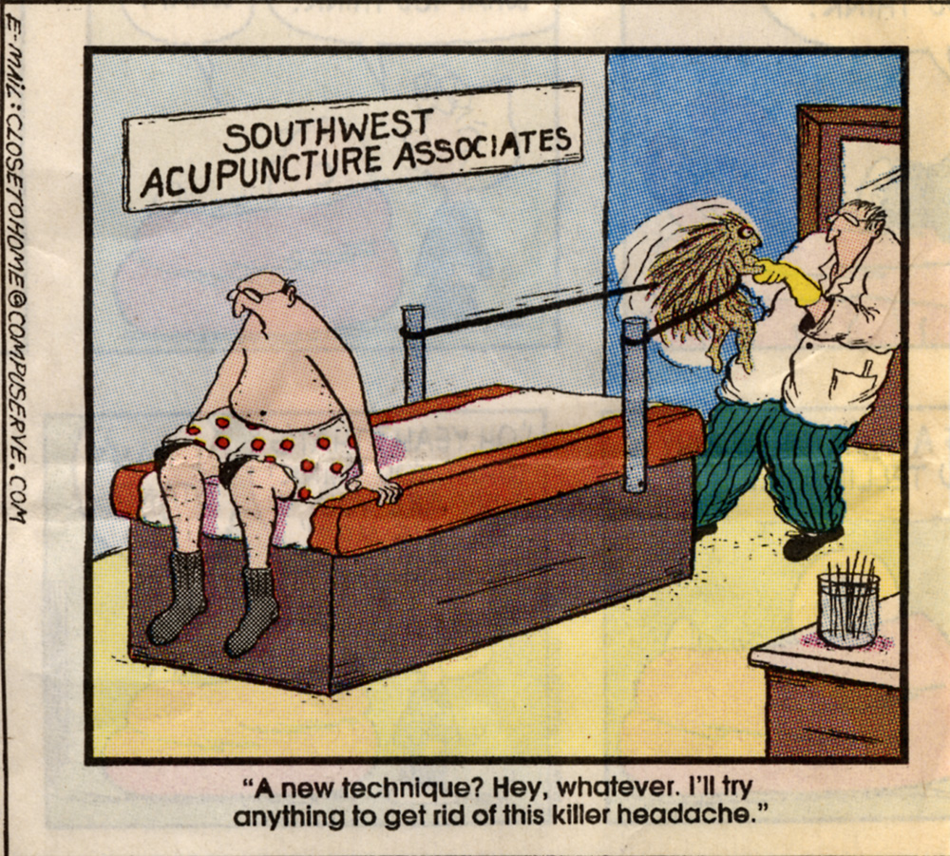
Division of Pediatric Anesthesiology

Slide 35
AURICULAR ACUPUNCTURE
Homunculus: somatotopic representation on brain, ear, hand, foot, scalp
Electrical Device to locate active points
Application of small needles retained for 3 days
Applications: Effective for MSK pain, HA, Abdominal pain, N/V, anxiety, depression, infertility, tinnitus, neuropathic pain
Characteristically: Fast, Effective, Subject to Fewer failures, Fewer SFX
Drawback: Minor Local Tenderness
Division of Pediatric Anesthesiology

Slide 36
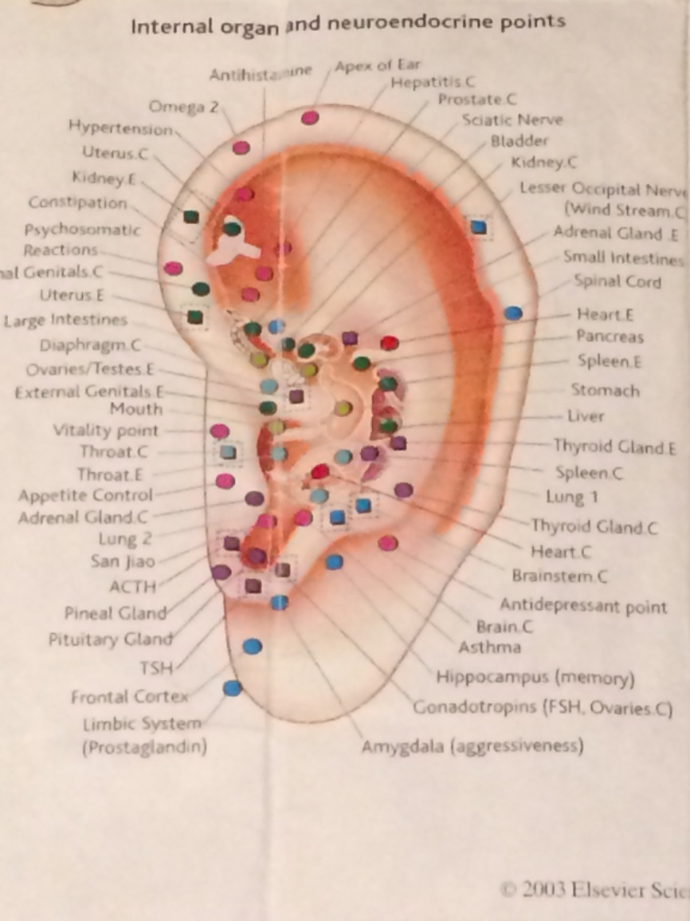
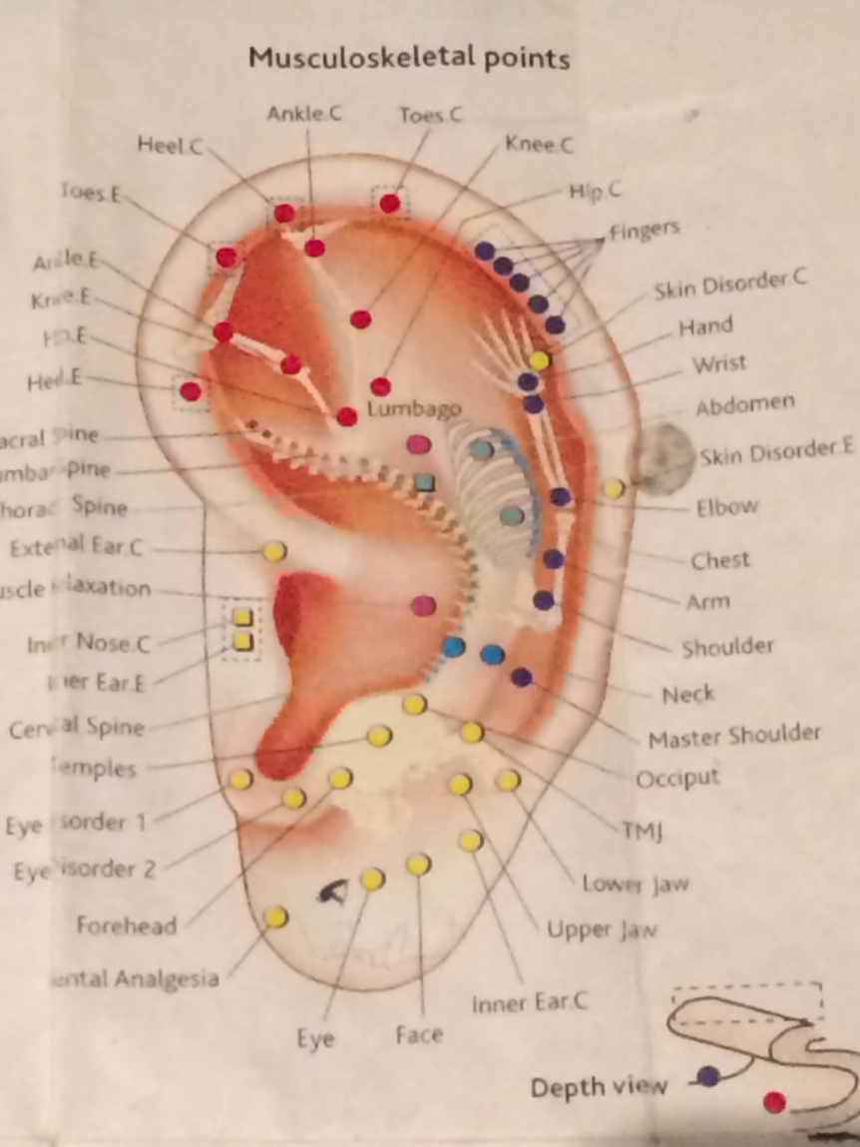
Auricular Homunculus
Division of Pediatric Anesthesiology

Slide 37
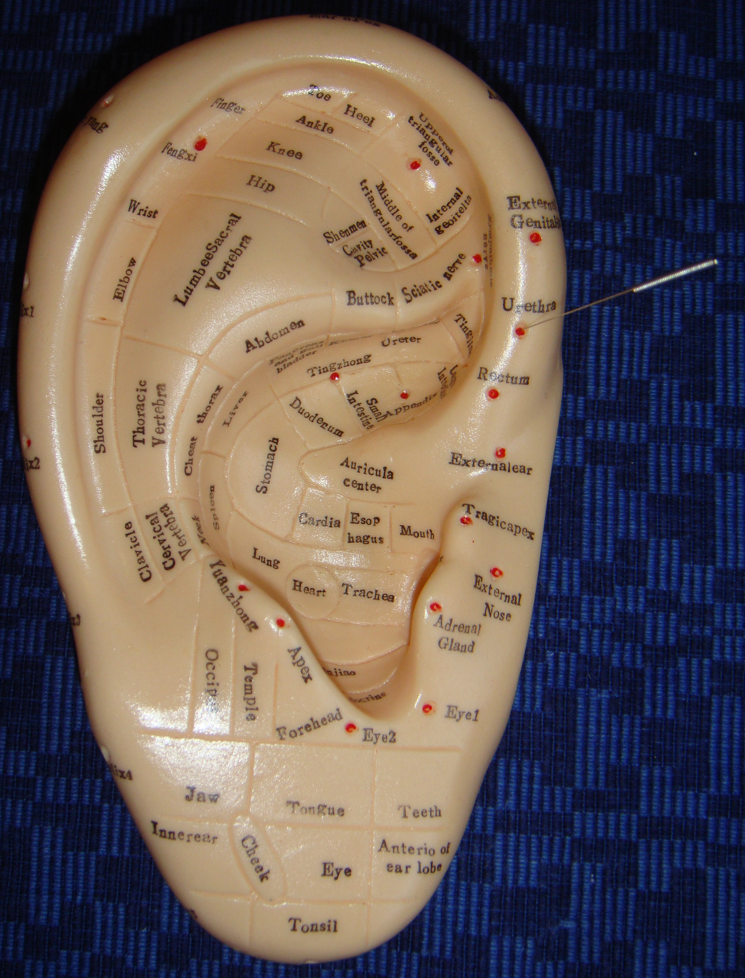
Somatotopic Representation on the Surface of the Auricle
Division of Pediatric Anesthesiology

Slide 38
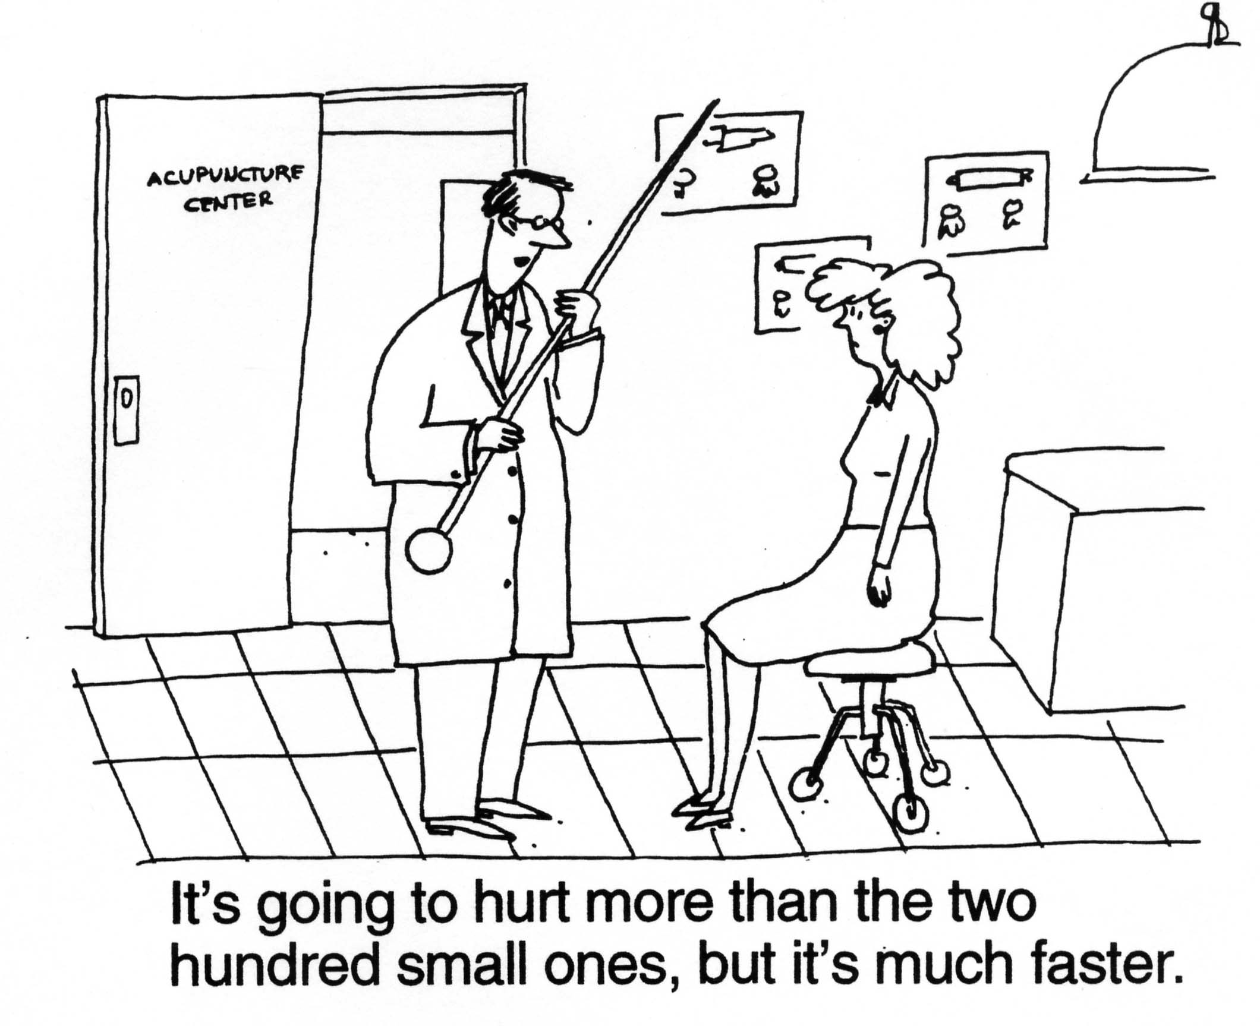
Division of Pediatric Anesthesiology

Slide 39
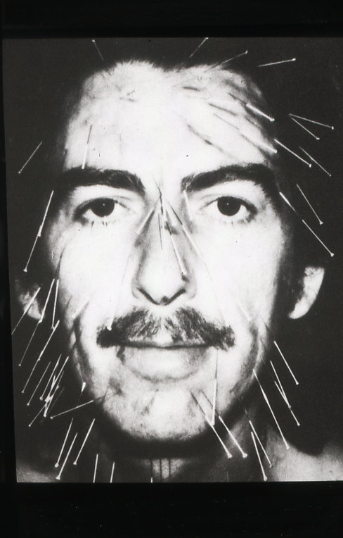
Division of Pediatric Anesthesiology

Slide 40
Auricular Semi Permanent Needles (ASP)
Acupressure beads
Division of Pediatric Anesthesiology

Slide 41
PROs CONs
Non-Pharmacologic
Avoid Drug SFX
Highly effective
Rapid Response
Minimal time, labor, cost
Well tolerated
Acupressure
Patient modesty with Ear
Bleeding
Infection
Needle Phobia
Tenderness
Division of Pediatric Anesthesiology

Slide 42
Contraindications
Failure to Obtain Consent/Assent
Pregnancy
Bleeding disorders
Pacemakers
Immunosuppression
MRI
Caution advised as swallowing hazard
Division of Pediatric Anesthesiology

Slide 43
Complications Are Rare
Bleeding
Infection
Exacerbation
Local reaction to metal
Vagal response
Division of Pediatric Anesthesiology

Slide 44
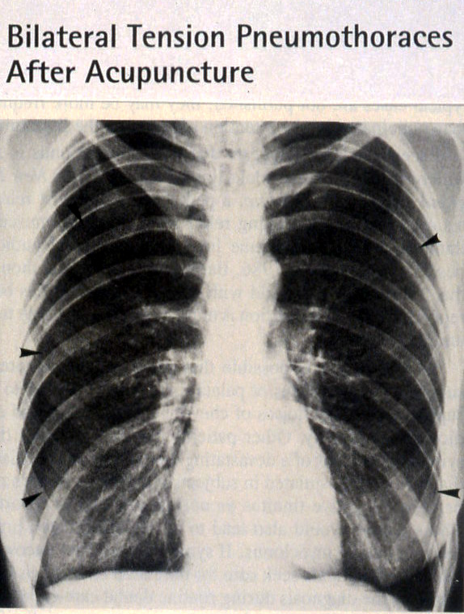
Division of Pediatric Anesthesiology

Slide 45
Cautions Following Treatment
Avoid strenuous activity
Avoid heavy meals
Avoid ingesting extremes of temperature
Avoid Alcohol
Auricular Acupuncture guidelines:
Remove after 3 days
Watch for signs of infection, irritation
Activity as tolerated
Remove needles/beads for MRI
Division of Pediatric Anesthesiology

Slide 46
Battlefield Acupuncture. Richard C. Niemtzow, MD. Medical Acupuncture: Volume 19, Number 4, 2007
Five points used on the auricle to rapidly decrease pain scores to level of zero to 1/10.
Cingulate Gyrus, Thalamus, Shen Men, Point Zero, Omega 2
Used in Military extensively to avoid narcotic use
Taught to many military MDs to provide rapid, predictable, profound pain relief in the battlefield

Slide 47
Additional Notes
Acupuncture vs Acupressure
Age/size of patient
Duration of disorder
Patient Attitude toward acupuncture is irrelevant to efficacy
Acute vs Chronic
Most challenging patients
Moxa vs infrared heat, cupping
Chinese Herbals

Slide 48
In Summary
Mechanism Poorly Understood
Very effective for common disorders
Non-pharmacological option
Minimal SFX
Tolerable by children
Children & Adults respond well
Division of Pediatric Anesthesiology

Slide 49
Riley Chronic Pain Clinic
Juliane Lee, MD
James Tolley, MD
Marti Michel, DPN
Mary Lynch Milder, PsyD
Amy Wagner, PsyD
Sarah Johnson, PT
Sarah Kewklish, PT

Slide 50
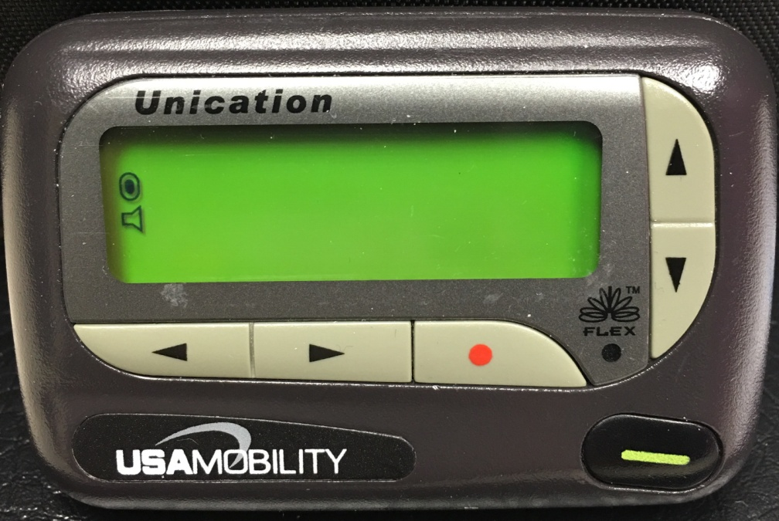
Contact Information
Contact me at
Email: JULHLEE@iu.edu
JLEE69@iuhealth.org
Division of Pediatric Anesthesiology

Slide 51
THANK YOU
To all my willing patients, who continue to teach me invaluable lessons.
To The Helms Medical Institute and the Medical Acupuncture Video Library, who provided some copyright material of HMI/MAVL.
To you for your attention & interest!
Division of Pediatric Anesthesiology

Slide 52
Additional Reading
Neuropathic Pain in Children: Special Considerations. G Walco, et al. Mayo Clin Proc. 2010; 85 (3) (suppl): S33-S41
An Update on the Pathophysiology of Complex Regional Pain Syndrome. S Bruehl. Anesthesiology 2010; 113:713-25
Complex Regional Pain Syndromes: New Pathophysiological Concepts and Therapies. C Maihofner, et al. Eur J of Neurology 2010, 17: 649-660.
Acupuncture Analgesia: I. The Scientific Basis. S Wang, et al. Anesthesia & Analgesia 2008; 106: 602-610
Acupuncture Analgesia: II. Clinical Considerations. S Wang, et al. Anesthesia & Analgesia 2008; 106: 611-621
Practical Approach to the child Presenting with Back Pain. R Haidar, et al. Eur J Pediatr 2010; Eur J Pediatr. 2011 Feb;170(2):149-56.
Recent Developments in Pediatric Headache. A Hershey. Curr Opin Neurol 2010, 23: 249-253.

